Slide 1
Game Design Challenge
GameCareerGuide.com
Every other Wednesday we'll present you with a challenge about developing video games. You'll have two weeks to brainstorm a brilliant solution. After the two week submission period elapses, the best answers and the names of those who submitted them will be posted.

Slide 2
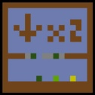
Desafio atual: The Grid
Design a game that works within the confines of a 32x32 grid
http://is.gd/gdchallenge0512

Slide 3
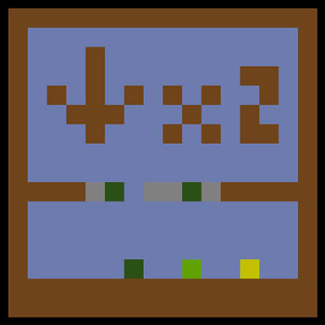

Slide 4
Assignment Details 1/4
As video game technology and hardware has advanced, developers have been able to make their games far more visually complex, with new rendering techniques, more detailed 3D models, and higher display resolutions. While this increased visual fidelity is all well and good, a real designer doesn't need to rely on stunning visuals to make a good game.

Slide 5
Assignment Details 2/4
For this latest Game Design Challenge, let's put that philosophy to the test. Rather than working with a high-definition display, with thousands of pixels to play with -- what if you had to make a game that worked within the confines of a 32x32 grid?

Slide 6
Assignment Details 3/4
That's a very small canvas to work with when it comes to making a video game, but there are plenty of examples that already work within a similar framework. Look at Checkers, Chess, or even Connect Four -- they might not be video games per se, but they all demonstrate the types of experiences designers can make within a limited, grid-based play space.

Slide 7
Assignment Details 4/4
Over in the digital realm […] When it comes to designing your 32x32 game, feel free to incorporate outside instructions or prompts to teach players how to play. If you'd like to put on-screen text below your grid, feel free, just make sure the game itself only uses colored squares on the 32x32 matrix. Good luck, and we can't wait to see what you come up with!

Slide 8
Submissão / Exercício
Submissions should be no more than 500 words and may contain up to three images.
When your submission is complete, send it to gamedesignchallenge@gamecareerguide.com with the subject line "Design Challenge: (title)." Please type your answer directly in the email body. Be sure to include your full name and school affiliation or job title.
Entries must be submitted by Wednesday, May 16
Results will be posted Tuesday, May 22

Slide 9
Nosso exercício Entrega: 20.05
Grupos 1-3 pessoas
Txt explicando o jogo [máximo 500 palavras]
Mais até 3 imagens
usar referencia no texto quando necessário: [image01.jpg]
Obs: as submissões para o GameCarrerGuide são individuais.

